Slide 1
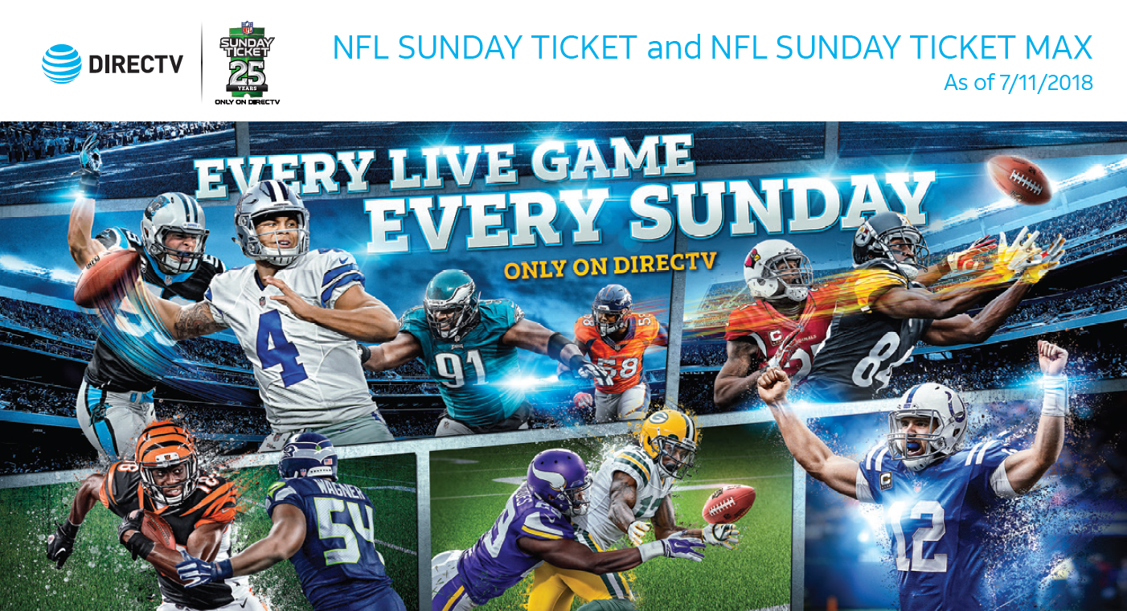

Slide 2
Items covered:
How to explain blackouts?
How to find my favorite NFLs team and their schedules?
Is NFL Sunday Ticket Free?
What comes with NFL Sunday ticket Max?
What tools do I use to check which channels covers NFL?
How do I find the NFL game schedules?
Can I access NFL through my DirecTV app? How?
NFL Sunday ticket Connected device access
NFL Saves and credit offers

Slide 3

Blackouts
In-market: RSN team territory customer belongs to based on geographical location. For example, customers in Boston are considered in-market for the Boston Red Sox territory, since NESN serves the Boston area.
Out-of-market: Games not in customer's RSN team territory. We make games available out-of-market by way of league packages, such as NHL Center Ice, NBA League Pass, MLS Direct Kick and MLB Extra Innings.
Blackouts: Viewing restrictions applied to out-of-market league packages to protect in-market territories. For example, if Los Angeles is an in-market territory for a customer, they can view a Dodgers vs. Sox game on FSN West. Customers across the rest of the country can view game by subscribing to MLB Extra Innings. If a customer subscribes to MLB Extra Innings and Sports Pack, but their zip code is not in Dodgers or Sox territories, they can see game on MLB Extra Innings channel (700s range) and their regional sports channel (600s range).
Mr. Customer, game blackouts protect teams, the sports leagues and stations purchasing rights to broadcast individual games. Leagues, sports associations, and programs control blackouts. In some areas, DIRECTV may no longer have rights to broadcast customer's games. You always visit www.directv.com/blackouts at any time for information on sports blackouts.

Slide 4
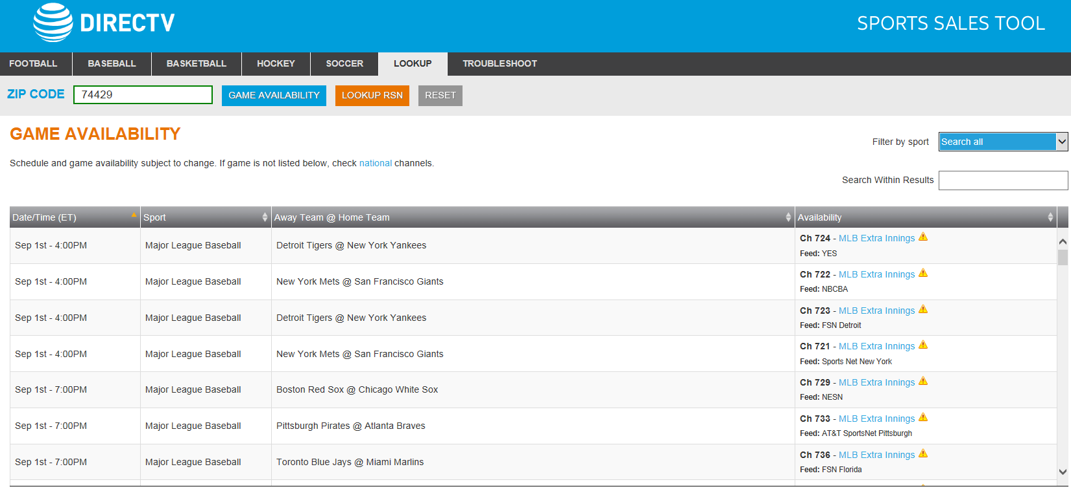
Sports Sales Tool
How-to….
Access ‘Sports Availability Tool’.
Click on LOOKUP tab to start search.
Enter customer's zip code and click GAME AVAILABILTY to display results.

Slide 5

Is NFL Sunday Ticket Free?
2018 Regular Season Offers
Note: On May 1, 2018, in the ordering systems, agents might notice Early Renewal Offers for NFL ST or NFL ST Max. The Early Renewal Offers have the same price and monthly payment options as Regular Season Offers, but should only be used for customers who had an NFL subscription the prior season.
Regular Season Offer: January 10, 2018 - October 20, 2018
Early Renewal Offer: May 1, 2018 - October 20, 2018
Season Dates : September 9, 2018 - December 30, 2018
NFL ST :
Every out-of-market game every Sunday (select International games excluded) all in HD, Game Mix Channels, Online and Mobile streaming access, Interactive TV App (Player Tracker), and real-time on-screen scores and stats.
Price : 6-pay at $48.99 ($293.94)
NFL ST Max :
Offer to customers who want the maximum football experience.
NFL ST Max includes all of the features from NFL Sunday Ticket plus access to Red Zone Channel and Fantasy Zone Channel.
Price : 6-pay at $65.99 ($395.94)
NFL ST Max (Add-On):
Offer to customers who already subscribe to NFL ST but now want access to Red Zone Channel and Fantasy Zone Channel.
The Add-On provides the equivalent of NFL ST Max.
Price : 6-pay at $17 ($102)
Mr. Customer, NFL Sunday Ticket is not for free. You can enjoy every out-of-market game, every Sunday with NFL Sunday Ticket for $48.99 good for 6 payments, so that’s a total of $293.94. Or for you to get every single minute of every game get NFL Sunday Ticket Max for 6 payments at $65.99 and that’s a total of $395.94.

Slide 6
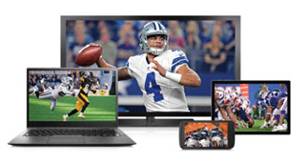
What comes with NFL Sunday ticket Max?
Red Zone channel (HD only):
Watch the most exciting plays as they happen, all on one commercial-free channel.
Where you never miss a play inside the 20 yard line.
Fantasy Zone channel (HD only):
A unique one-of-a-kind channel only available from DIRECTV.
Live and commercial-free hosted channel designed for the most avid fantasy football fans.
Go from game-to-game to watch real-time performance of your favorite NFL fantasy players and get the latest analysis from our fantasy football experts.
Short Cuts: Stream full-game replays in 30 minutes or less, with no commercials, on your smartphone, tablet, or computer/laptop.
NFL ST Online (PC or Mac):
Watch NFL ST games anywhere on your computer/laptop (PC or Mac).
Watch 2 games at once, 1 on your living room TV and 1 on your computer/laptop.
Note: Access to Red Zone Channel and Fantasy Zone Channel require NFL ST Max subscription.
NFL ST Mobile (Phone/Tablet):
Watch NFL ST games anywhere on your tablet or mobile device.
Watch 2 games at once, 1 on your living room TV and 1 on your tablet or mobile device.
Closer to the start of the season, download the DIRECTV NFL Sunday Ticket App from your mobile device's app store.
Note: Access to Red Zone Channel and Fantasy Zone Channel require NFL ST Max subscription.

Slide 7
NFL Sunday ticket Max also includes the following features…
Game Mix channels (HD only):
8-Game Mix Channel: Watch up to 8 games at once on a single TV screen.
4-Game Mix Channel: Watch up to 4 games at once on a single TV screen. Delivers more ways to watch NFL games.
Interactive TV App (Player Tracker) (HD only): Track up to 20 players throughout the day with real-time alerts and stats. Get on-screen scores and stats by pressing the red button on your remote from any NFL ST game channel. Get updates from the game you are watching without missing any of the action. Requires an interactive HD receiver.
NFL Network:
Included with your NFL subscription.
Note: NFL Network is also included with select base packages. No NFL Sunday Ticket subscription required.
Fantasy Football TV App:
Access your NFL.com Fantasy Football league information right on your TV.
NFL ST or NFL ST Max subscription is not required.
Aside from what NFL Sunday Ticket can offer, you can up your game to NFL Sunday Ticket Max to get the exclusive DIRECTV Red Zone Channel where you will never miss a play inside the 20 yard line- commercial free. You can also have access to Fantasy Zone Channel to watch real-time performance of your favorite players and get the latest analysis from our fantasy football experts- commercial free.

Slide 8
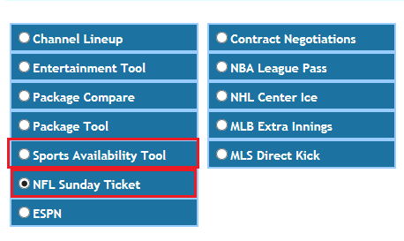
What tools do I use to check which channels covers NFL? How do I find the NFL game schedules?
Work Flow Engine (WFE)
In WFE, follow Inform > Programming
To check for the NFL channels:
Inform > Programming> Sports Availability Tool > Football > Channels
To check for channels and dates:
Inform > Programming > NFL Sunday Ticket > Channels and Dates
To check for the NFL game schedules:
Inform > Programming > NFL Sunday Ticket > AT&T and Authorized Retail > NFL schedule> www.DIRECTV.com/NFLschedule

Slide 9
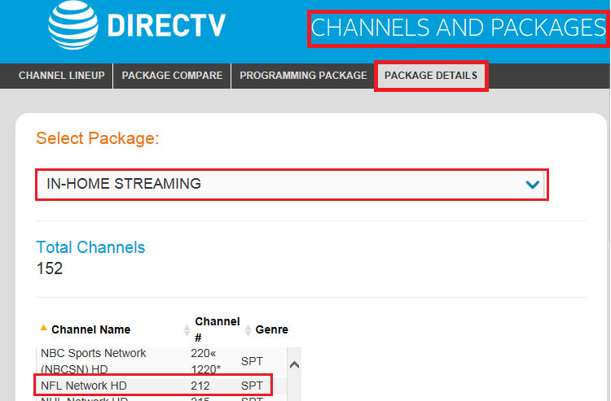
Can I access NFL through my DirecTV app? How?
DIRECTV App
Available Programming/Channels
Live TV Streaming Channels
In- Home Streaming
NFL Mobile/Online Access
NFL Sunday Ticket App
Download the 2018 DIRECTV NFL Sunday Ticket App from their mobile device's app store
NFL ST Online (PC or Mac)
1. Go to www.DIRECTV.com/nfl.
2. Enter your DIRECTV.com username and password to login and follow the "Start Watching" button to launch 2. 2. NFL ST Online (on Sundays during the regular season). If you need a username/password, simply register at DIRECTV.com.
Note :
Customers can only access from one online or mobile device at a time (PC/Mac or smartphone or tablet or connected device). If a second login attempt is made with the same username/password, the second login will fail. Customers must logout of their current viewing session before attempting to login on another device (example, logout of your laptop computer before you login to your iPhone). Do not transfer to the Account Unlock team for customers who are unable to login on a new device. The Account Unlock team cannot force the original device to log out. Customers must simply logout of their original device before attempting to login on a new device.
This is as easy as 123, Mr.Customer. From the Home Page of your Directv App, scroll down to the Live TV Streaming section or select Watch on Phone and Watch Live TV then select View All. Or, From the Home Page, tap the Main Menu button then tap on Live TV Streaming.

Slide 10
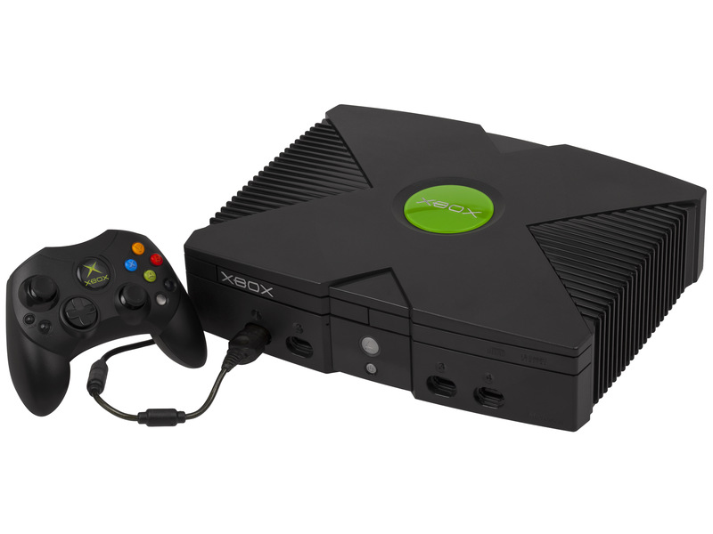

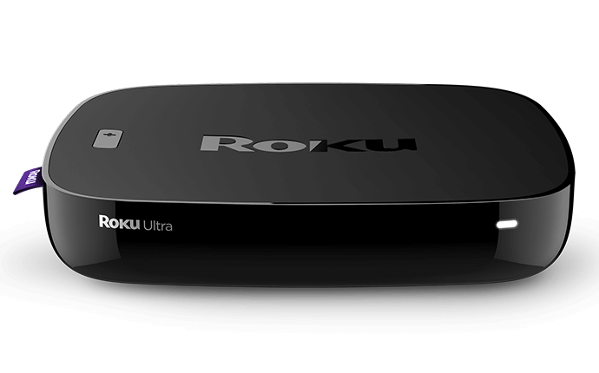
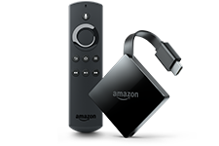
DIRECTV Satellite Customers
App Features
Game Streams
Live scores and stats
Highlights & In-app alerts
Customizable Game Mix
60 frames per second (fps) video
Stadium mode & Shortcuts
Picture-in-Picture (PiP)
Red Zone Channel Note: Only available with NFL ST Max.
Fantasy Zone Channel Note: Only available with NFL ST Max.
Customers can use their connected device menus for help, guidance, or answers to FAQs.
For additional contact information and support, see Contacting Console Providers.
Availability
DIRECTV satellite customers who subscribe to NFL ST or NFL ST Max can access NFL Sunday Ticket games at no additional cost, on their connected device.
See directv.com/nflappdevices for a list of supported connected devices (e.g., Xbox One, Chromecast, Roku, Amazon Fire TV).
Connected devices follow the same game availability rules as NFL Sunday Ticket with two exceptions: Device Location and Stadium Blackouts
NFL Sunday ticket
Connected device access

Slide 11
Non-DIRECTV Satellite Customers
These subscribers don't have a DIRECTV satellite account in the billing system. These subscribers have purchased a subscription for NFL Sunday Ticket through NFLSUNDAYTICKET.TV (Non-DIRECTV Customers).
Availability
See NFLSUNDAYTICKET.TV (Non-DIRECTV Customers) if callers don't have a DIRECTV satellite account in the billing system, but want access to NFL Sunday Ticket. They may be eligible to order online through the NFLSUNDAYTICKET.TV website.
Requirements
See directv.com/nflappdevices for a list of supported connected devices (e.g., Xbox One, Chromecast, Roku, Amazon Fire TV).
Subscription to NFLSUNDAYTICKET.TV
Download the NFL Sunday Ticket App from your connected device's app store.

Slide 12
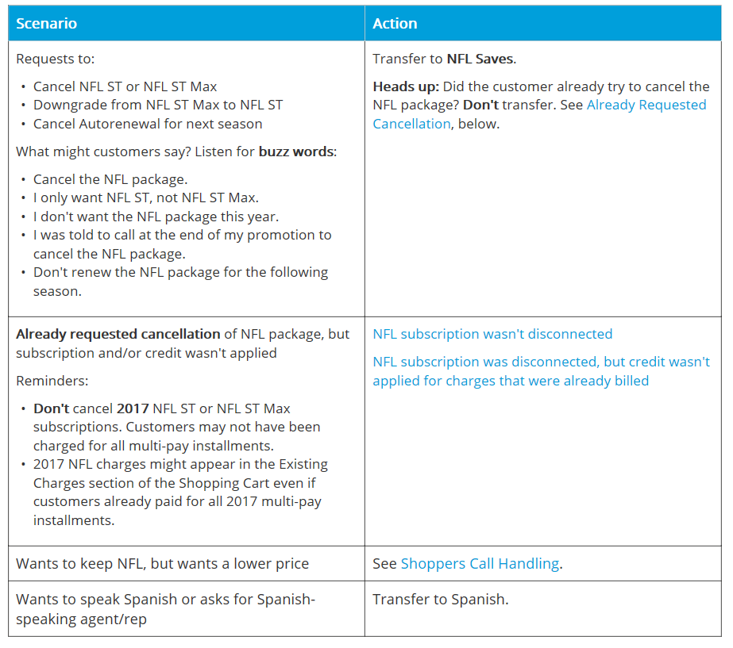
NFL Cancel / Downgrade Requests
NFL Saves and Credit offers
I am surprised you want to cancel NFL Sunday Ticket. It's a very popular product, and I've added it for many customers today. Tell me why you want to cancel?

